Slide 1

Welcome to Telerik Academy
Class of 2013-2014, Fall 2013
academy.telerik.com

Slide 2

Table of Contents
About Telerik
About Telerik Academy
How to be Successful at Telerik Academy

Slide 3
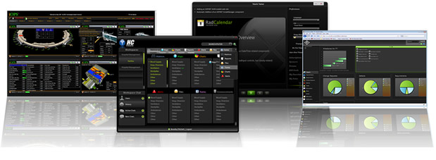
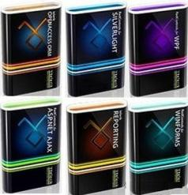
About Telerik
What Makes Telerik so Successful?

Slide 4
About Telerik
A Bulgarian company with headquarters in Sofia
With 11 offices in USA, Australia, UK, India, Germany and Denmark
Just opened an office in the Silicon Valley
Telerik provides Applications Development Solutions
Developers have all the tools to create a top-notch applications for web, mobile and native
Tools for application lifecycle management
PM, development, testing, etc..

Slide 5
Telerik Products
Telerik products
UI components for most .NET technologies and productivity tools (DevCraft)
HTML5/JavaScript development (Telerik KendoUI)
Mobile apps development (Telerik Icenium)
Mobile backend services (Telerik Everlive)
Application Analytics (Telerik EQATEC)
Software testing tools (Test Studio)
Agile project management (Telerik TeamPulse)
Web CMS (Telerik Sitefinity)

Slide 6
Why Telerik is Successful?
Hard Work
Essential to the success of any company
Good People
The greatest asset of the company
Constant Improvement
Adaptive to changes
Innovation
Create, don’t follow
Open Communication
Everyday feedback and improvement of our products

Slide 7
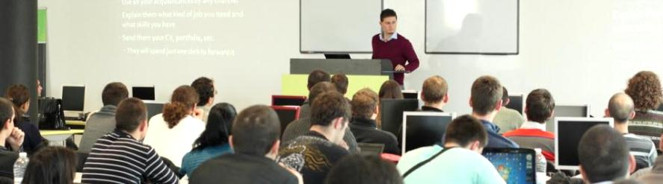

Free Trainings for Software Engineers

Slide 8
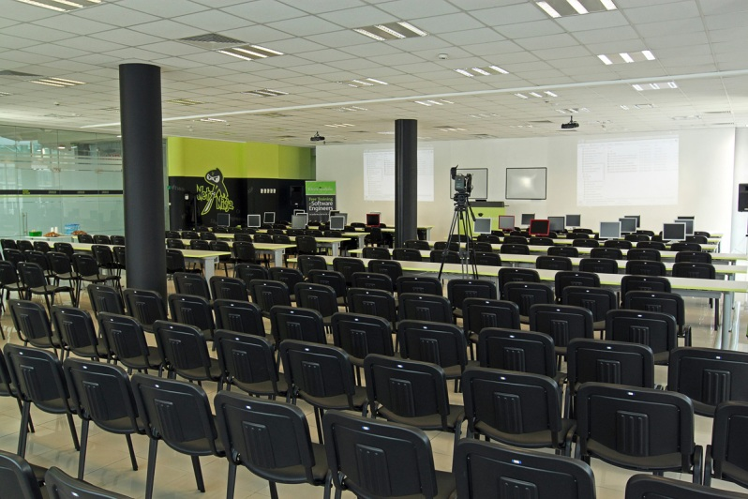

About Telerik Academy
Free training of young software engineers
Telerik Academy: .NET Devs, Web & XAML Front-Ends, QAs, Dev-Supports
Kids Academy
School Academy
Algo Academy
Online Courses
Contests

Slide 9
Learning Tracks
Kids Academy
School Academy
Online Courses
Algo Academy
Telerik Academy
Programming
HTML & JS
Team Work
Mobile Dev.
Web Dev.
Native Dev.
QA
Dev. Support

Slide 10


“Telerik Academy" Program
What is It? How It Works?
The Learning Tracks

Slide 11
The Telerik Academy
Become a skillful software engineer for free
It takes 12 months of learning, homework, projects, team work
Web development track (HTML5, JavaScript, …)
Programming track (C#, OOP, DB, …)
Professional tracks
ASP.NET Web Developer, XAML Developer, QA, Support Engineer, Web Front-End, Mobile Dev, Windows 8 Dev, Cloud Dev, System Admin, …

Slide 12
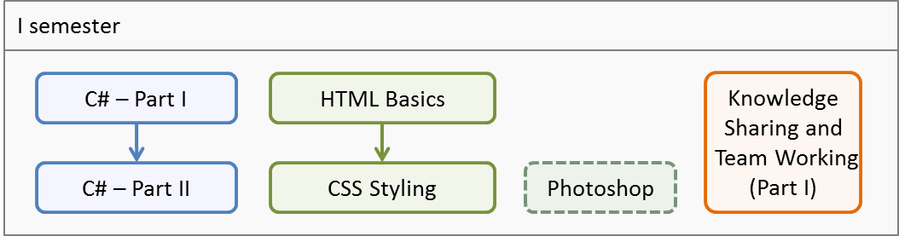
First Semester
C# programming and Web technologies basics
Autumn group (Oct 2013 – Jan 2014)
500 students onsite
2 times weekly, 4 hours in class + homework
3 team work projects

Slide 13
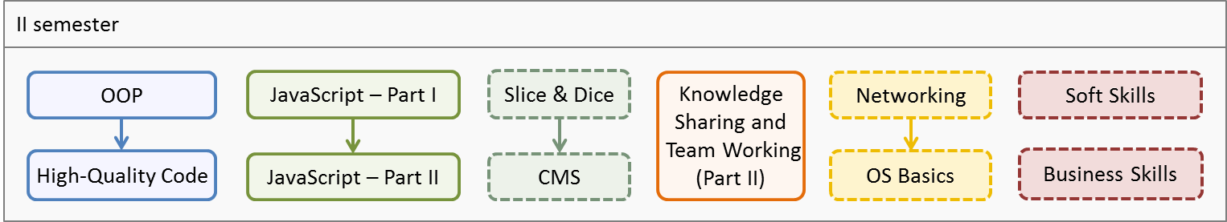
Second Semester
Advanced C# programming and JavaScript
Elective courses: TBA
Jan 2014 – May 2014
<400 students onsite
3 times weekly, 4 hours in class + homework
3 team work projects

Slide 14
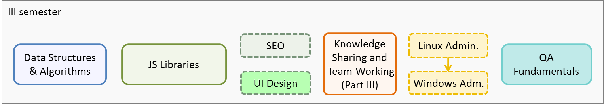
Third Semester
DS & Algorithms and JS Applications
Elective courses: ex. SEO, UI Design
QA Academy start
May 2014 – June 2014
<300 students onsite
3 times weekly, 4 hours in class + homework
2 team work projects

Slide 15
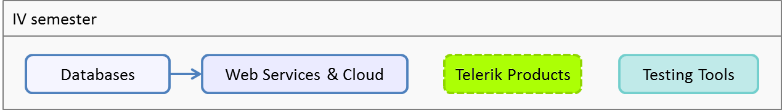
Fourth Semester
Databases and SQL
Web services & cloud development
Telerik products and tools
July 2014
<200 students onsite
Full time (5 times weekly, 8 hours in class)
1 team work project

Slide 16
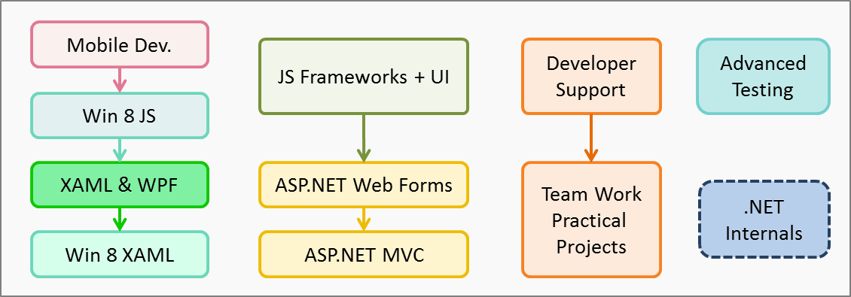
Fifth Semester
Professional tracks
August 2014 – September 2014
100 students onsite
Full time (5 times weekly, 8 hours in class)
3 team work projects

Slide 17
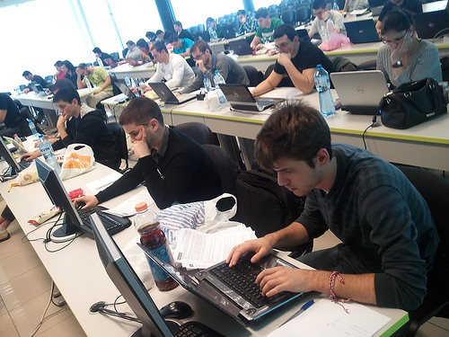

What is Required of You:
100% Commitment!

Slide 18
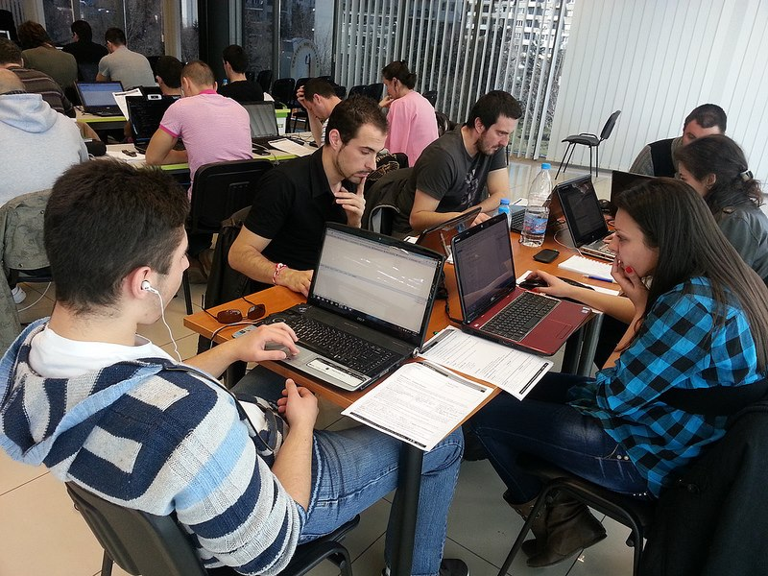
What is Required of You?
Basic computer skills
We don’t teach computer literacy
English
Serious attitude
Long-term commitment

Slide 19

Full Commitment
Key factors for succeeding at Telerik Academy
Solid motivation & attitude
Willingness to work hard!
“Cheaters” are not welcome
Invest time and efforts
50% in class (for the lectures and exercises)
50%-500% at home (for the homework)
All your energy for knowledge sharing

Slide 20
Welcome to Telerik Academy!
http://academy.telerik.com

Slide 21
Free Trainings @ Telerik Academy
Fundamentals of C# Programming Track of Courses
csharpfundamentals.telerik.com
Telerik Software Academy
academy.telerik.com
Telerik Academy @ Facebook
facebook.com/TelerikAcademy
Telerik Software Academy Forums
forums.academy.telerik.com

